Slide 1
Handling Production Issues
How to make your boss think you’re Superman

Slide 2
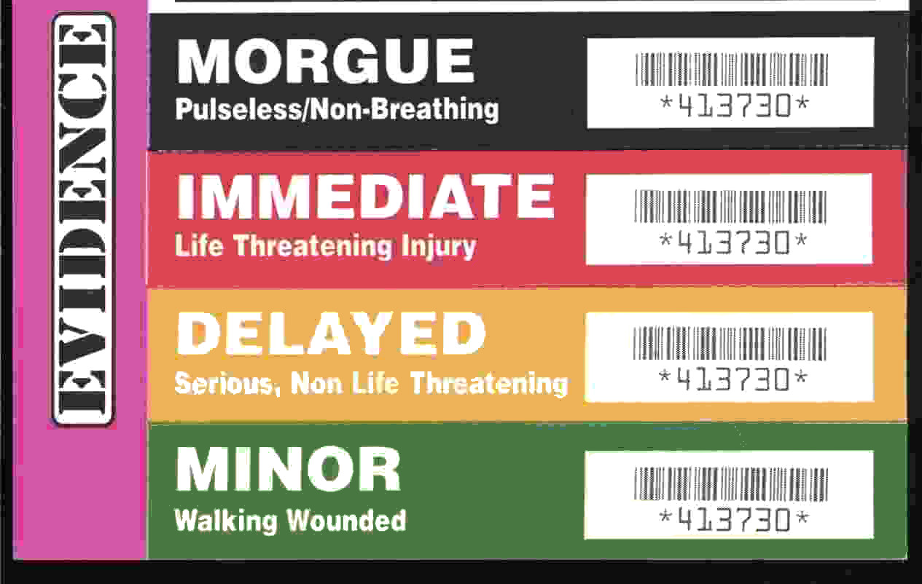
Triage - the sorting of patients (as in an emergency room) according to the urgency of their need for care
http://www.merriam-webster.com/dictionary/triage
Notes:
This term was popularized in World War I by French doctors treating the wounded at aid stations. They would sort the wounded into three categories:
Those who are likely to live, regardless of what care they receive;
Those who are likely to die, regardless of what care they receive;
Those for whom immediate care might make a positive difference in outcome.

Slide 3
Triage Steps
What environment?
How many people are affected?
What are the symptoms?
Does it happen all the time or intermittently?
Try to narrow down where the issue is occurring
Client-side?
Server-side?
Backend services?
Database?
Third-party?
Notes:
When a production issue is reported we need to first triage, or diagnose, that issue to decide how we should deal with it.
What environment? This seems obvious but we’ve had situations where a miscommunication delayed our response to the issue. Even just this week, someone asked me if the RavenDB server was having and issue because the website was timing out and wouldn’t load. I knew the server was fine because I had just checked it, so I asked what they were seeing happen. At that point they mentioned the QA site wouldn’t load.
How many people are affected? Not to downplay the importance of issues that might only be affecting a few people, but this will affect our response to the issue. Should we drop everything to focus on the issue or is this something we should refer to QA to investigate further? COMMUNICATION IS KEY. A couple months ago an issue occurred that was affecting everyone, but I inferred from the person I was talking to that the issue was of minor importance and only affecting some people. Because of that, the issue lasted for over an hour before the underlying problem was resolved. The failure went both ways, they never mentioned that it was happening across the board, and I never asked.
What are the symptoms? This may described like “When I click x then y happens.” We need a description of the problem with as much detail as possible so that we aren’t led down the wrong path. Once we get the initial description we can ask more questions to help us narrow down where the issue is occurring. From there we can begin looking at that particular process. We have a lot of interconnected systems, so narrowing down whether the issue is with the phone controls, call routing, general application, or something else will help us resolve the issue as quickly as possible.
This will also determine our next steps. Do we begin looking at the servers? Do we talk to the database team? Do we need to contact a third-party and report the issue?
These last two points will start to inform us on how we should approach resolving the issue, so we can then dig deeper, which brings us to… debugging.

Slide 4
Debugging
Gather details
IDs
Time of occurrence
Expected behavior
Actual behavior
Reproducible?
Is it safe to reproduce the issue?
Check the logs
Check all the logs
Increase logging level or try other tracing (e.g. IIS)
Memory dump?
Notes:
QA will often do a lot of this for us, and by the time it’s come to us we’ll already know whether it’s an environment issue or it’s a bug in the system. If we can reproduce the issue locally or in QA, it’s generally easier to debug it there.
If we can only reproduce the issue in production, we need to determine whether we can safely do so. We don’t want to cause more problems or corrupt data.

Slide 5
Logging
Don’t log too much
Don’t log too little
Info = normal log level for production
Debug/Verbose = local/dev/sometimes QA
Log exceptions
AppDomain.CurrentDomain.UnhandledException
TaskScheduler.UnobservedTaskException
Event Log
Contextual information is vital
IDs
“Call has ended” vs “Call 12345 has ended with status Transferred”

Slide 6
Diagnose the issue
“The tool isn’t working”
Type : System.Data.SqlClient.SqlException
Message : A network-related or instance-specific error occurred while establishing a connection to SQL Server. The server was not found or was not accessible. Verify that the instance name is correct and that SQL Server is configured to allow remote connections.

Slide 7
Tools
Visual Studio
"Debug Managed Memory" available in VS2013 Ultimate
WinDbg
Memory/Performance Profilers
Process Explorer
Process Monitor

Slide 8
Demo
Notes:
Demo managed stack traces in ProcessExplorer

Slide 9
Memory Dumps
Memory Leaks
Use a profiler when possible
Random crashes
Check the logs first
If even you missed it in logging the Application Event Log might have it
Deadlocks
Infinite loops
Notes:
ONLY TAKE A DUMP AS A LAST RESORT – IT IS A SLOW AND PAINFUL PROCESS!
Try to reproduce memory leaks locally so you can use a profiler
Process crash may have logged the exception by using the tricks mentioned previously, don’t forget to check the Event Log

Slide 10
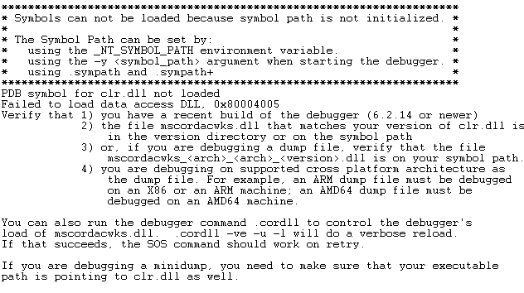
Configuration

Slide 11
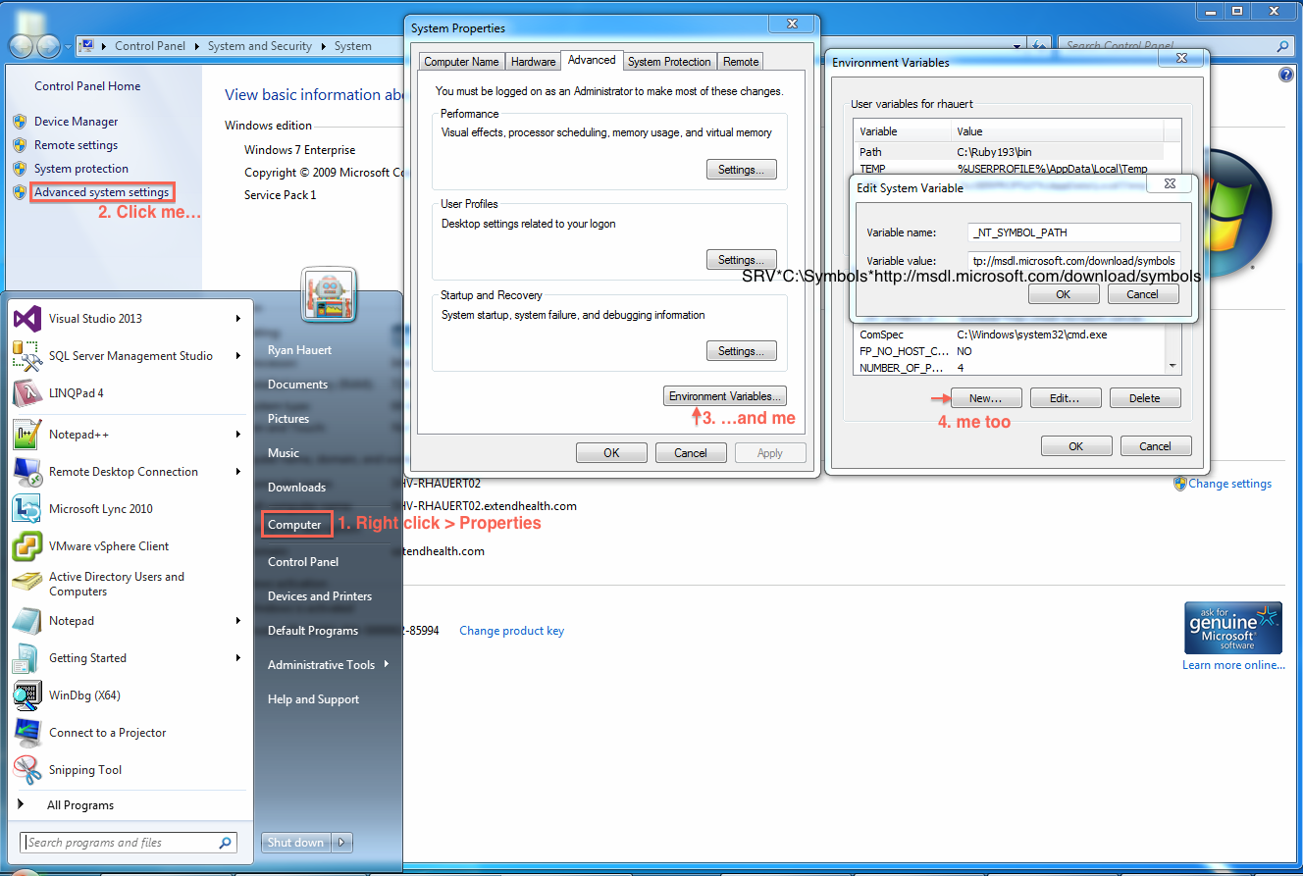

Slide 12
Demo

